Slide 1
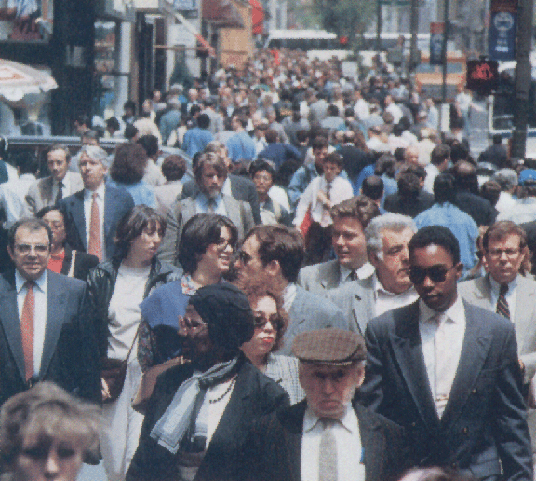
Microevolution
Microevolution considers mechanisms that cause generation-to-generation changes in allele/gene frequency within populations, below the level of species change.
Changes over a short period of time

Slide 2
Please note…
Individuals DO NOT evolve…
Populations DO

Slide 3
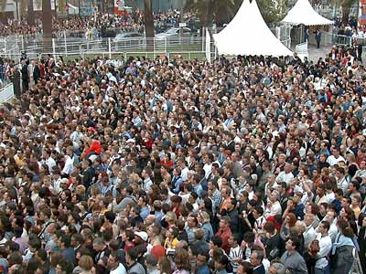
Populations, Allele Frequency Change, and Microevolution
A population is a group of interbreeding organisms present in a specific location at a specific time.
Allele/Gene frequency is the frequency of a particular allele/gene in the population.

Slide 4
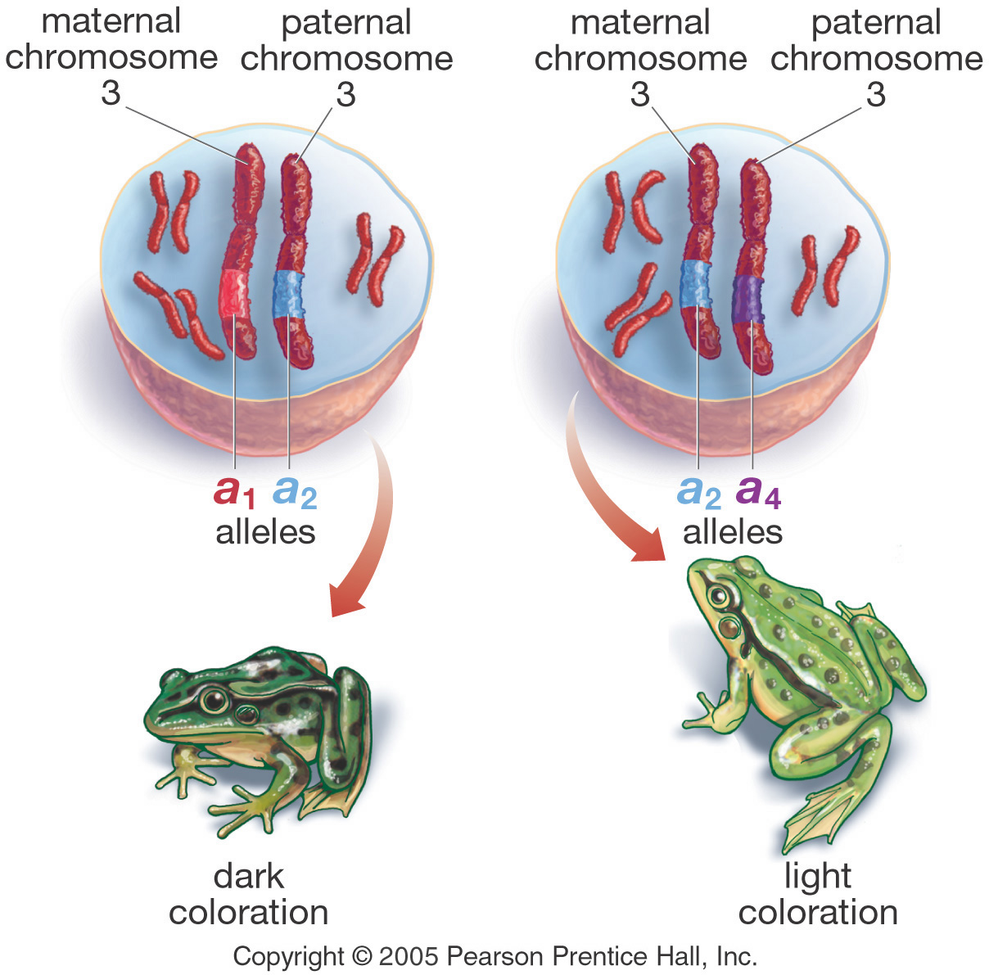
The Genetic Basis of Evolution
For evolution to occur, genetic differences must at least partially account for phenotypic differences.

Slide 5
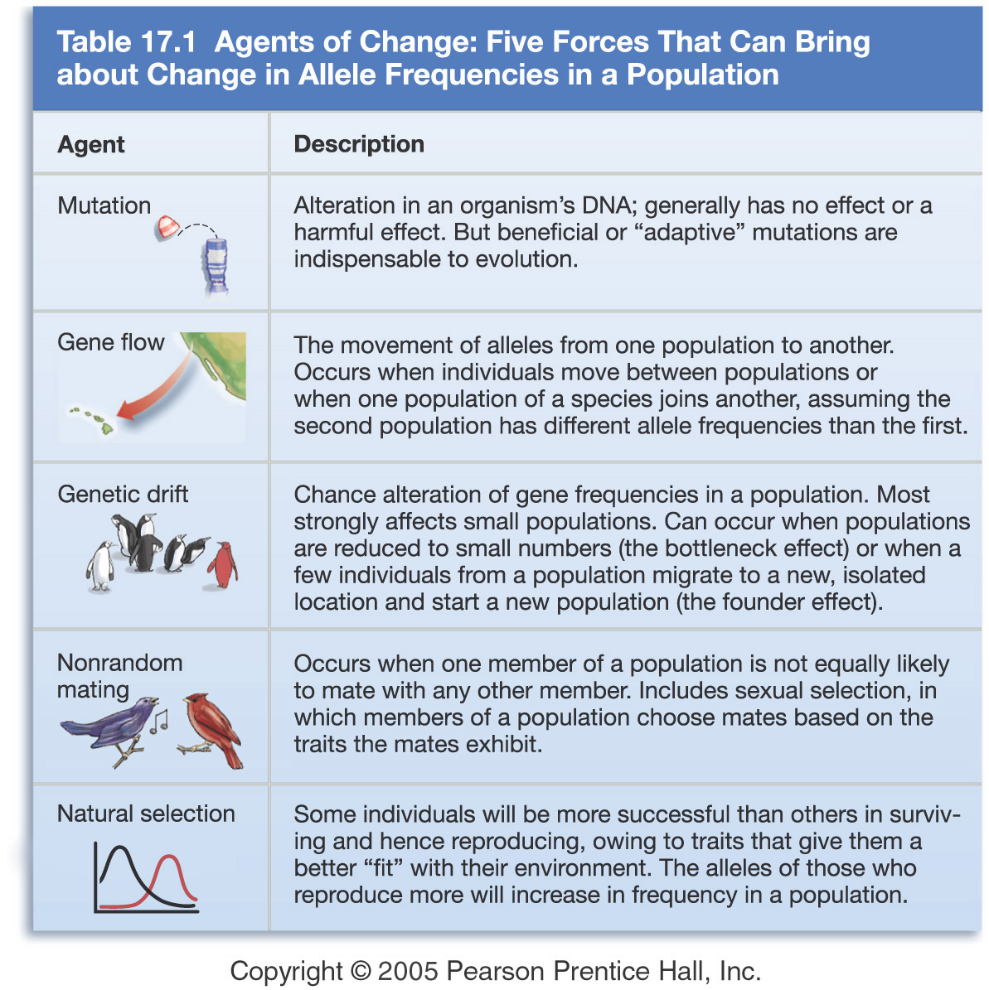
What Drives Evolution?
There are 5 factors of change.
If none of these factors are present then the population will
not change. It will be in Hardy Weinburg Equilibrium.
Only natural selection makes a population better adapted (more fit) to its environment.

Slide 6
Mutations
A change in the nucleotide sequence in a genome of an individual
Only source of additional genetic material and new alleles
Mutations may arise as a result of unrepaired changes in DNA sequences or chromosome breakage and rejoining.
Although most mutations occur in (body) cells, these mutations cannot be inherited and, therefore do not play a role in evolution

Slide 7
Mutations
But when they occur in a gamete (sex cell), it will have the potential to be passed on to later generations, and enter into the gene pool → a heritable mutation
The mutant alleles and any new phenotypes they produce become the source of new raw material for natural selection

Slide 8
Mutation Types
Neutral: no immediate effect on individual fitness
Harmful: reduces an individual’s fitness to survive
Beneficial: results in an enhanced gene product to produce a new or improved protein giving an individual a selective advantage and hence reproductive success

Slide 9
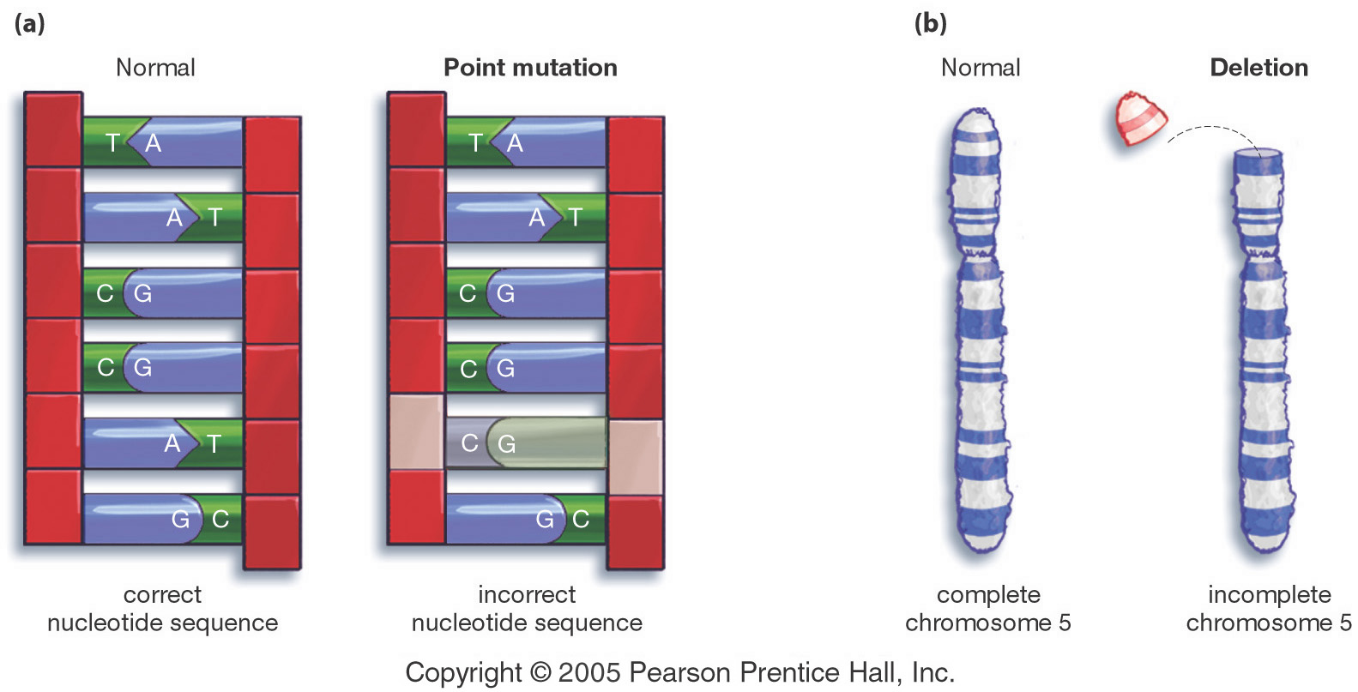
Mutations Provide Raw Material For Evolution
One type of mutation at the level of the gene.
One type of mutation at the level of the chromosome.
Mutations are usually neutral or harmful in their effects; only rarely are they beneficial.

Slide 10
Mutations “Just Happen”
Mutations occur at random without regard to whether they have a beneficial, neutral or harmful effect.
For this reason, mutations are a randomly acting evolutionary force.

Slide 11
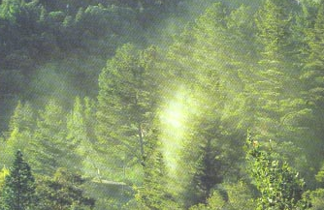
Gene Flow or Migration
The movement of alleles from one population to another through the movement of individuals or gametes
Gene flow makes separate populations more similar genetically.
The effects of gene flow are seen in many human populations, including the U.S. population.
Gene flow in plants – wind-dispersed pollen moving between Monterey pines.

Slide 12
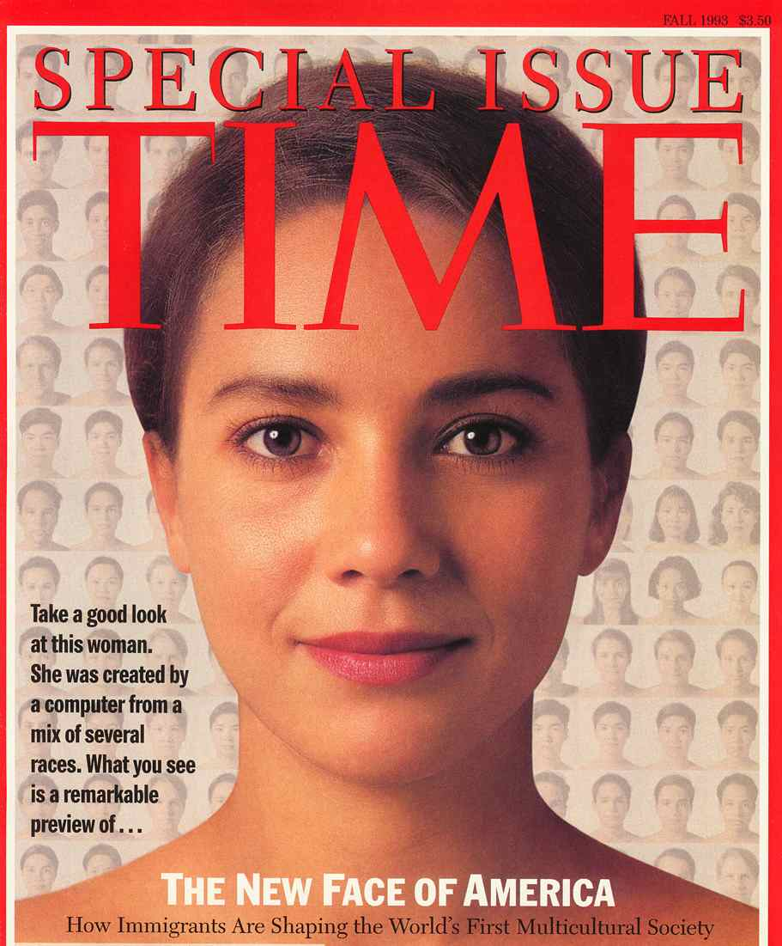
Gene Flow or Migration

Slide 13
Genetic Drift
The change in frequencies of alleles due to chance events
When populations are small, chance can play a significant role in altering allele frequencies (coin flipping example)
This tends to increase differences between populations

Slide 14
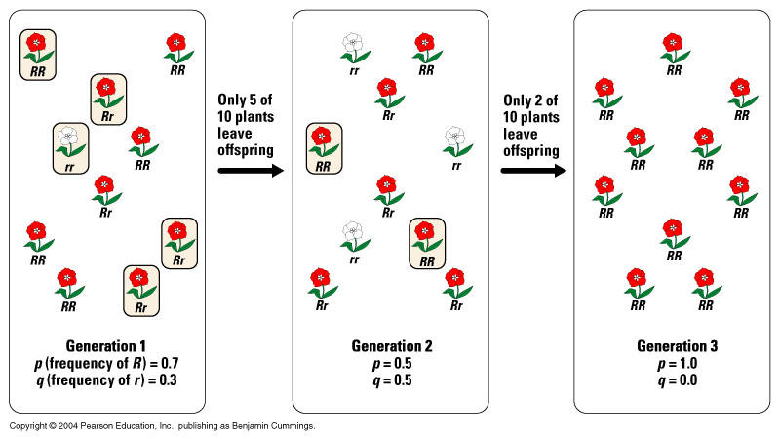
Genetic Drift
Genetic drift is random fluctuation in allele frequency between generations.
The effects of genetic drift are pronounced in small populations.

Slide 15
http://www.youtube.com/watch?v=mjQ_yN5znyk

Slide 16
Genetic Drift
2 situations can lead to significant genetic drift:
  Bottleneck Effect
  Founder Effect

Slide 17
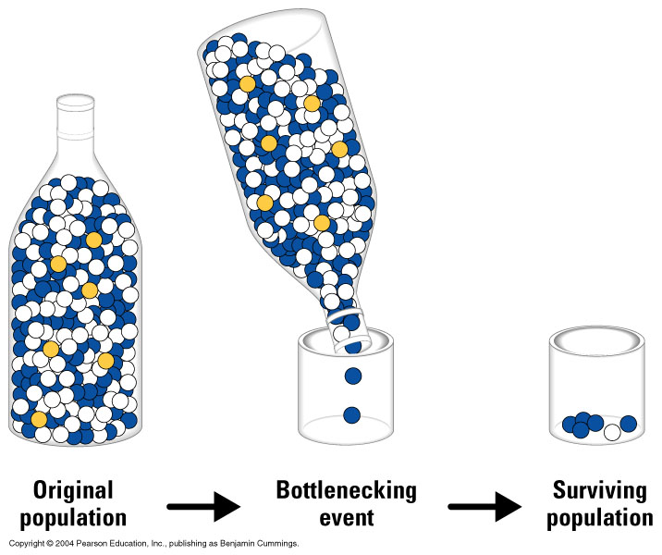
A Genetic Bottleneck is a Form of Genetic Drift
In a genetic bottleneck, allele frequency is altered due to a population crash.
Once again, small bottlenecked populations = big effect.

Slide 18
Possible bottleneck reasons
Starvation
Disease
Human activities
Natural disasters
A quick reduction in size of a population
Gene pool loses diversity (small fraction of alleles are left in the population)

Slide 19
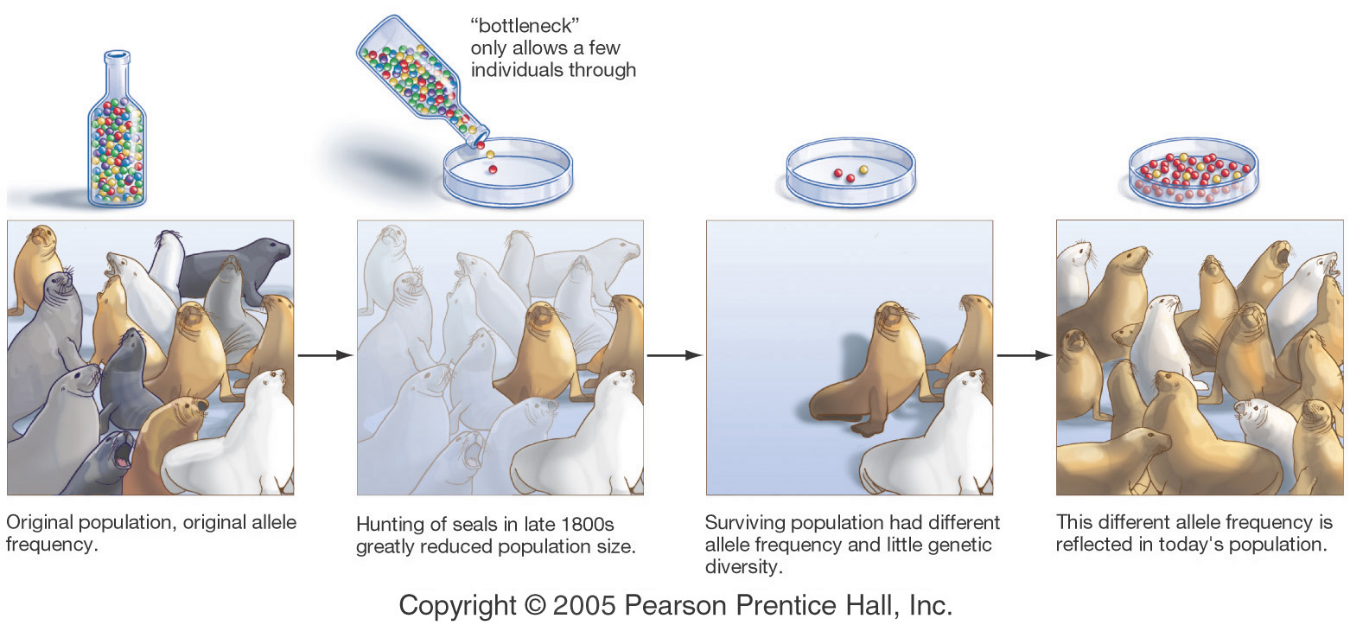
Genetic Bottleneck – A Historical Case
Note: A genetic bottleneck creates random genetic changes without regard to adaptation.
A severe genetic bottleneck occurred in northern elephant seals.
Other animals known to be affected by genetic bottlenecks include the cheetah and both ancient and modern human populations.

Slide 20
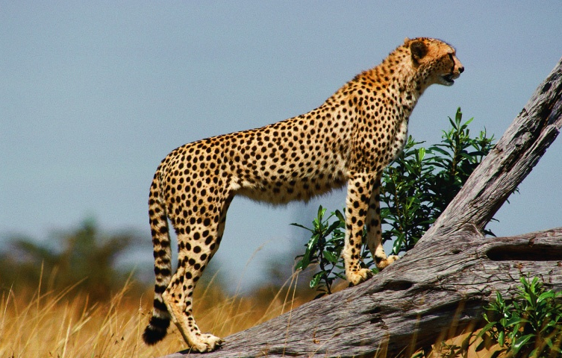
Endangered Species Are in the Narrow Portion of a Genetic Bottleneck and Have Reduced Genetic Variation

Slide 21
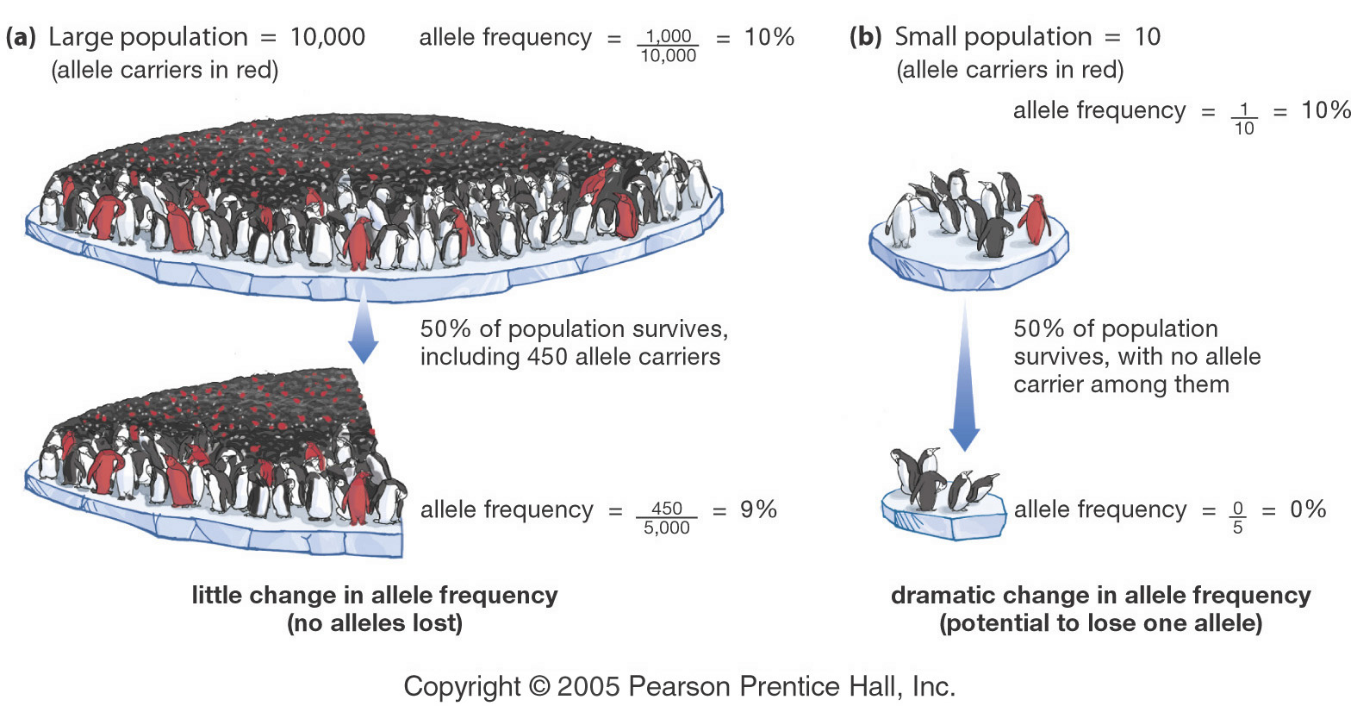
The Effect of Genetic Drift is Inversely Related to Population Size
Large populations = small effects.
Small populations = large effects.

Slide 22
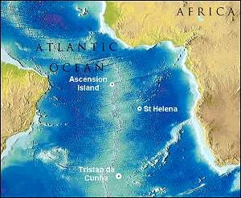
The Founder Effect is Another Variation of Genetic Drift
A founder effect occurs when a small number of individuals from one population found a new population that is reproductively isolated from the original one.
Migration from England

Slide 23
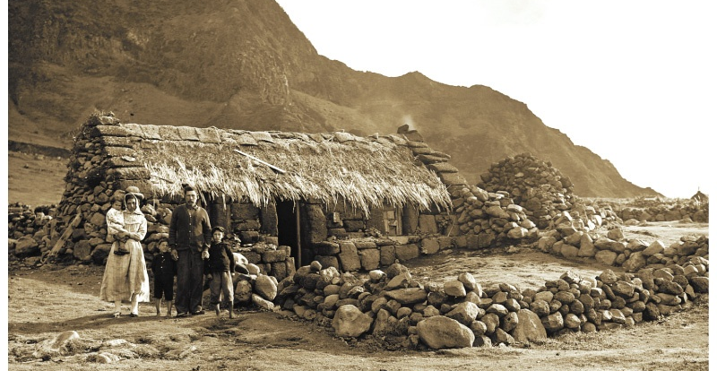
The Founder Effect is Another Variation of Genetic Drift
The South Atlantic island of Tristan da Cunha was colonized by 15 Britons in 1814, one of them carrying an allele for retinitis pigmentosum. Among their 240 descendents living on the island today, 4 are blind by the disease and 9 others are carriers.

Slide 24
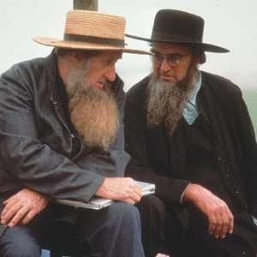
The Founder Effect
Old Order Amish populations are derived from a few dozen colonists who escaped religious persecution in Germany in 1719 to settle in Pennsylvania.
The community is closed.
Allele and genetic disease frequencies in Amish are significantly different from the German ancestral and the surrounding local populations.

Slide 25
The Founder Effect
Also have a high degree of polydactylism (6th finger or toe)

Slide 26
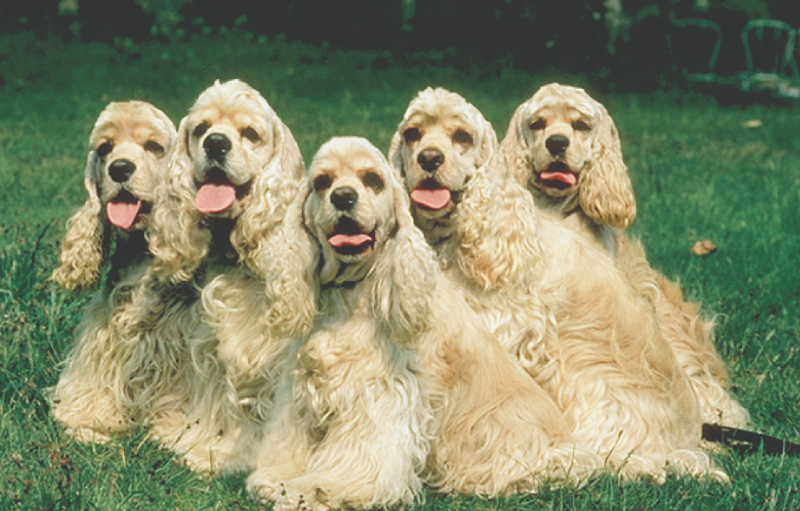
Non-Random Mating
Non-random mating occurs when there is a bias of mate selection for a particular phenotype or due to inbreeding
Cute, but prone to genetically-based disorders.
Inbreeding is preferential mating with relatives.
Inbreeding is a common form of non-random mating.
Inbreeding increases the frequency of homozygosity relative to random mating, elevating the frequency of recessive genetic disorders.

Slide 27
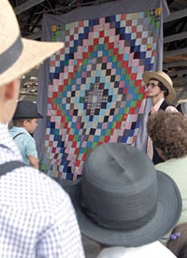
Non-Random Mating
The high frequency of particular recessive genetic disorders seen in many closed communities is a consequence of the founder effect and inbreeding.
Remember that inbreeding includes matings of distant relatives – the Amish have never practiced marriage between sibs or other immediate relatives.

Slide 28
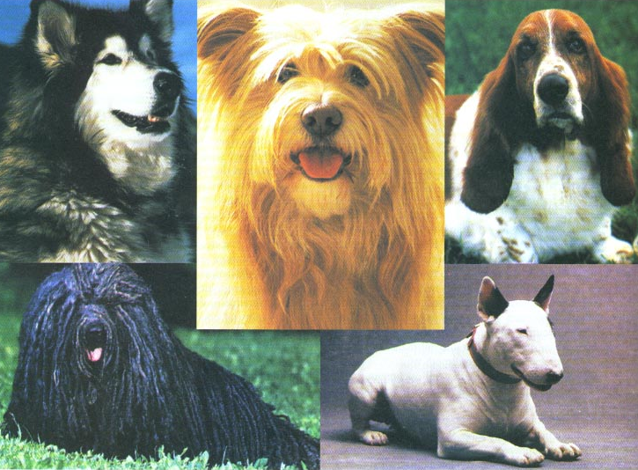
Natural Selection
Natural selection leads to adaptation – an increase in the fitness of a population in a particular environment.
Natural selection works because some genotypes are more successful in a given environment than others.
Successful (adaptive) genotypes become more common in subsequent generations, causing an alteration in allele frequency over time that leads to a consequent increase in fitness.
It’s not natural – but this is one outcome of strong selection.

Slide 29
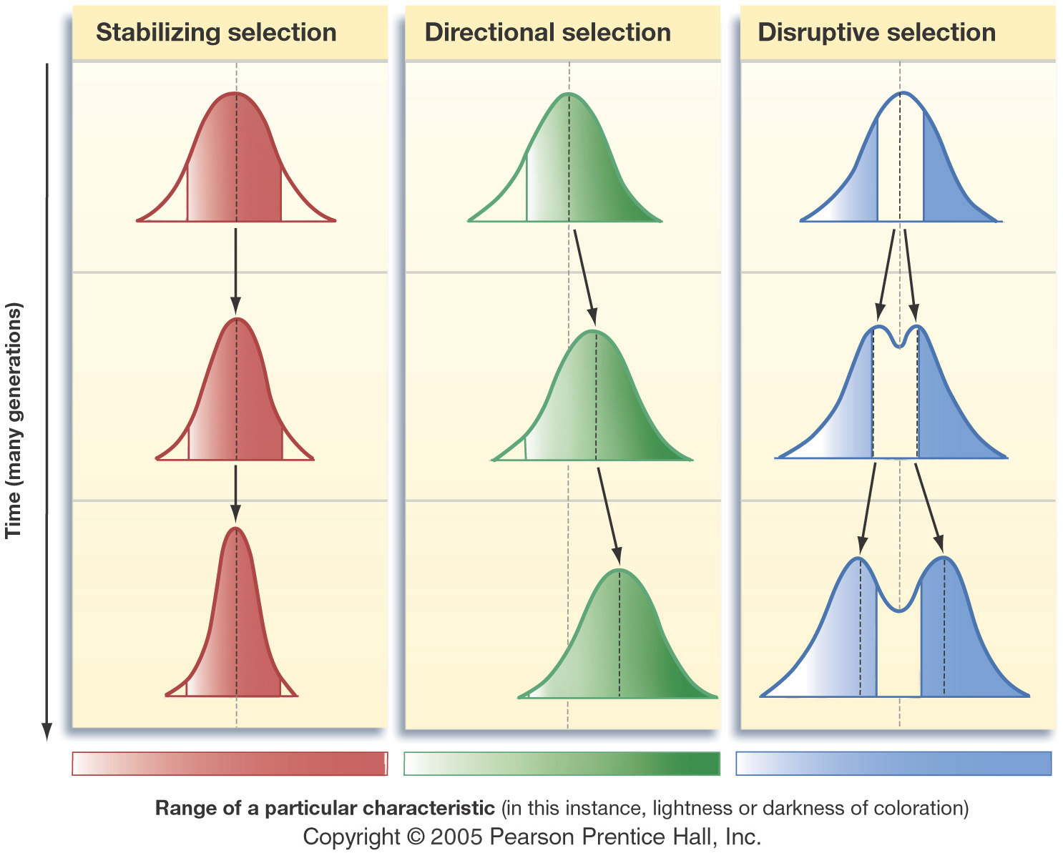
Three Forms of Natural Selection (p.307)

Slide 30
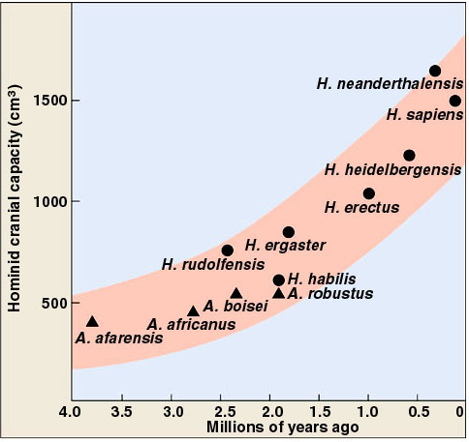
Directional Selection
Hominid Brain Size

Slide 31
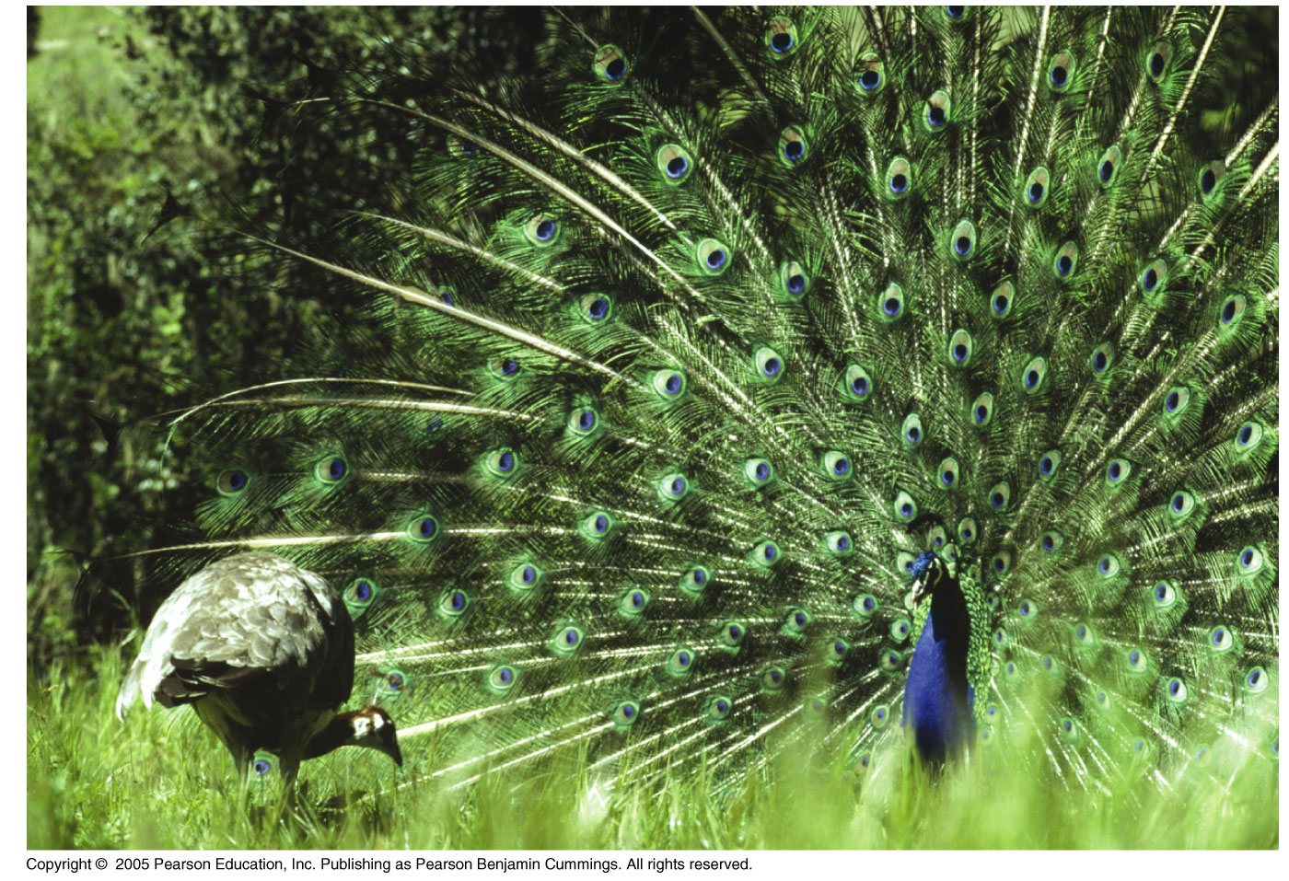
Directional Selection
[Sexual Selection]

Slide 32
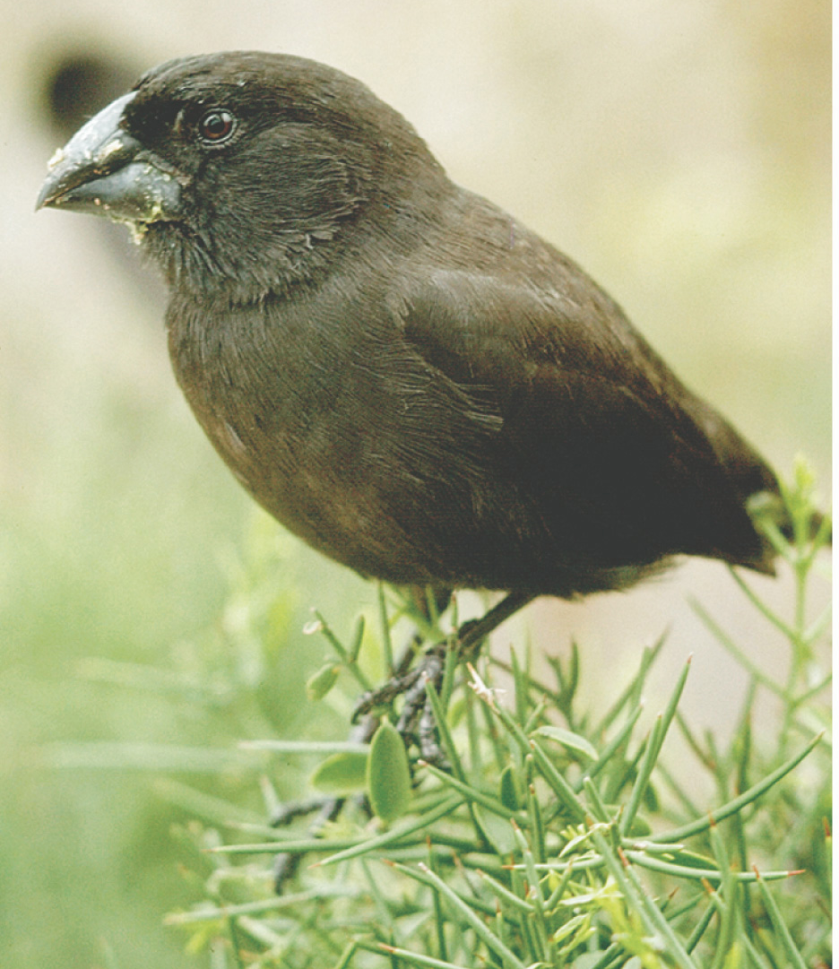
A Galapagos Finch, the Subject of a Classic Study of Evolution in Action
Peter and Mary Grant and their colleagues observed how beak depth, a significant trait for feeding success, varied in populations experiencing climactic variations.

Slide 33
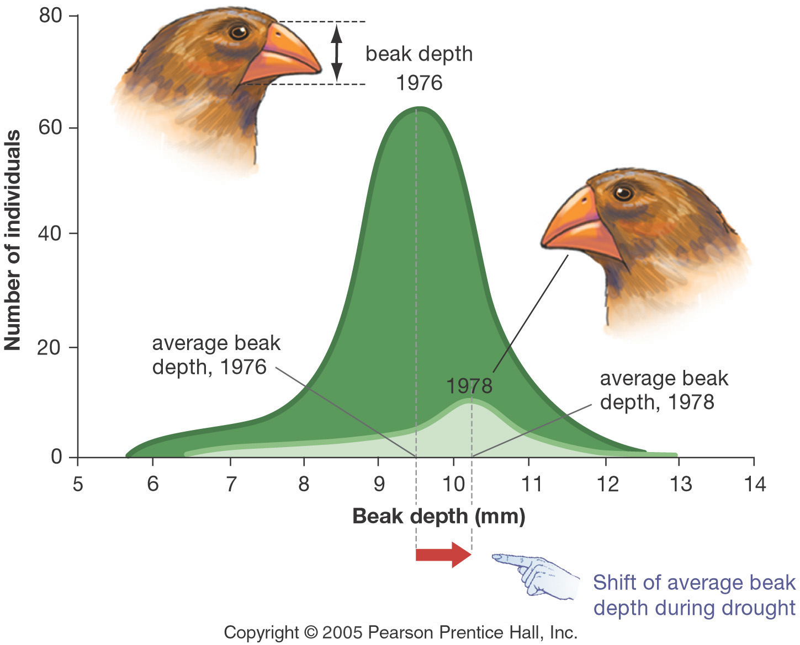
Beak Depth Changed in a Predictable Way in Response to Natural Selection
Significantly, beak depth is a genetically determined trait.

Slide 34
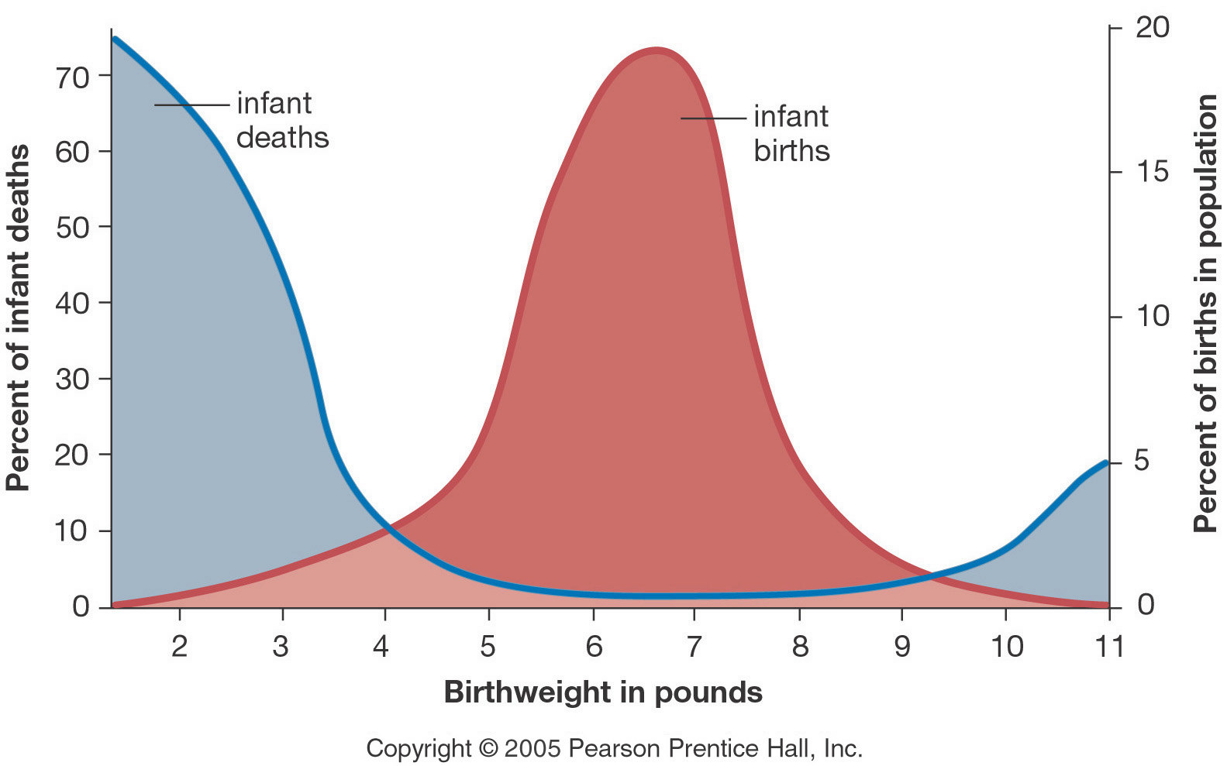
Human Birth Weight Is Under Stabilizing Selection
Modern medicine relaxes this and other forms of selection.

Slide 35
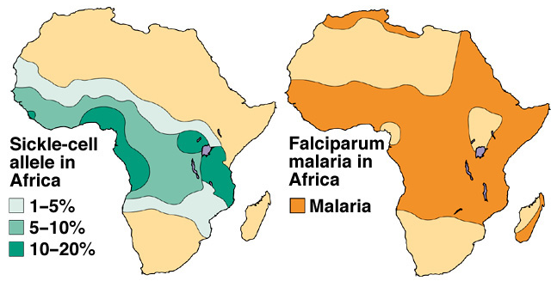
Stabilizing Selection for the Sickle Cell Allele
In heterozygous form, the sickle cell allele of β-globin confers resistance to malaria. Therefore, the allele is maintained, even though it’s harmful in homozygous form.

Slide 36
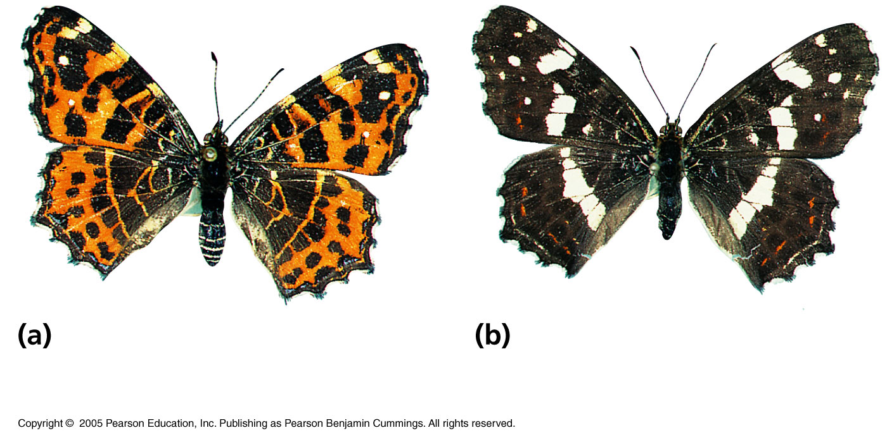
Disruptive Selection
Spring Colors
Late Summer Colors

Slide 37
TED ED
http://ed.ted.com/lessons/five-fingers-of-evolution

Slide 38
Homework
P. 359 #1-3, 5-9, 11

